Slide 1
Chapter 17 Waves in Two and Three Dimensions
http://www.falstad.com/ripple/
https://en.wikipedia.org/wiki/Doppler_effect
http://www.soundsnap.com/tags/doppler

Slide 2

Chapter 17 Waves in 2D
Waves are common in our surroundings and can be seen in water, heard via sound, and travel as light through space.
https://www.youtube.com/watch?v=dsrUxhaaWks
https://www.youtube.com/watch?v=LkYDs-q50mY

Slide 3
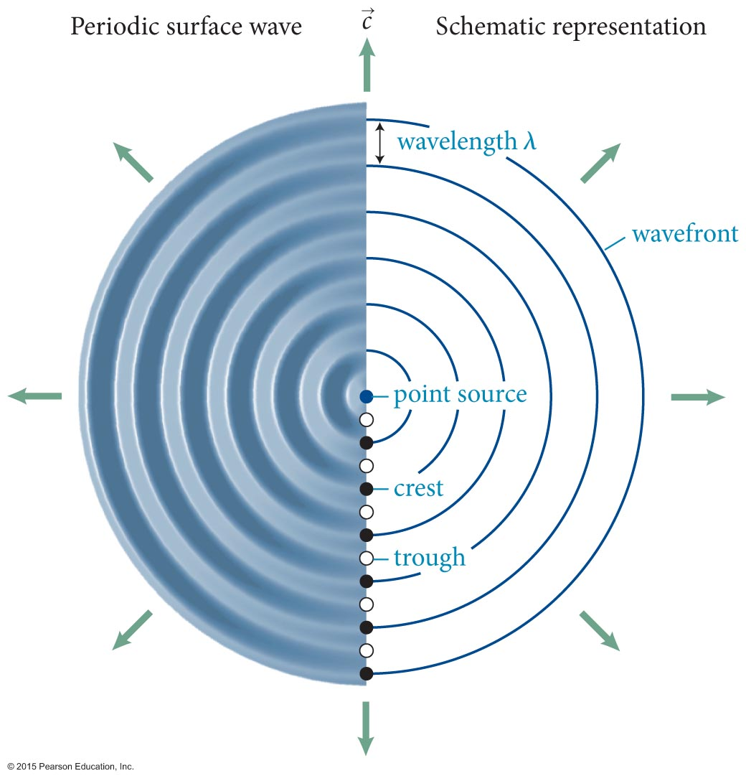
Section Goals
Section 17.1: Wavefronts
Define the concepts of a wavefront and represent their motion graphically.
Recognize the geometry of surface waves

Slide 4
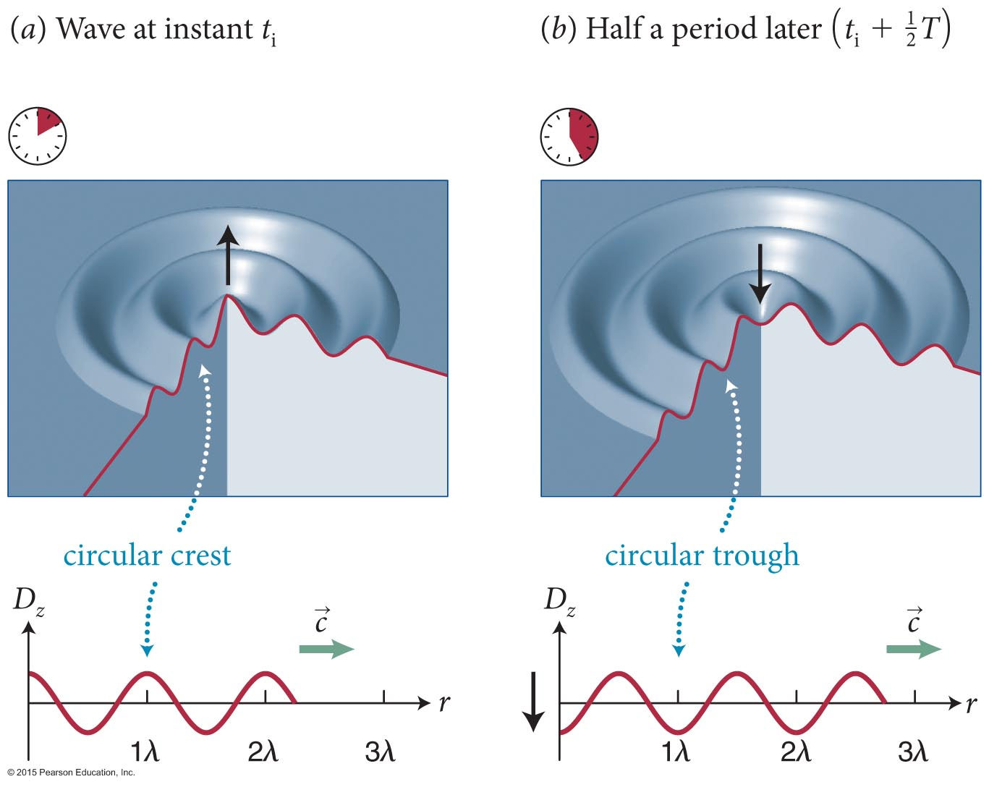
Section 17.1: Wavefronts
The figure shows cutaway views of a periodic surface wave at two instants that are half a period apart.

Slide 5
Section 17.1: Wavefronts
When the source of the wavefront can be localized to a single point, the source is said to be a point source.
The figure shows a periodic surface wave spreading out from a point source.
The curves (or surfaces) in the medium on which all points have the same phase is called a wavefront.
wavefront

Slide 6
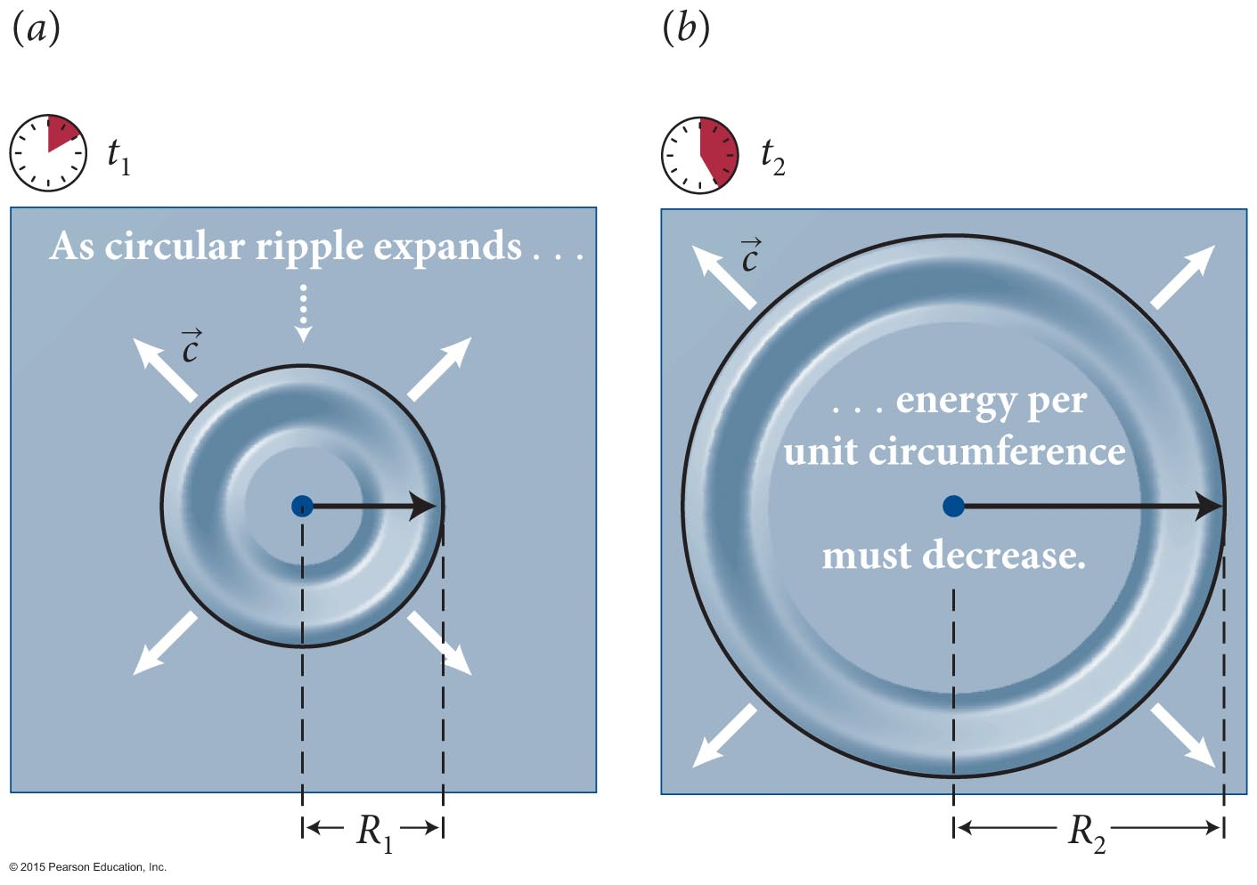
Section 17.1: Wavefronts
Consider the figure.
If we assume that there is no energy dissipation, then there is no loss of energy as the wave moves outward.
As the wavefront spreads, the circumference increases, and hence the energy per unit length decreases.

Slide 7
Section 17.1: Wavefronts
Energy per length of string in 1D: E/L = ½μω ²A² (Eq. 16.41).
If energy is conserved then E is constant.
so
Since E is constant, the amplitude A(R) must
decrease as the wave expands.

Slide 8
Checkpoint 17.1
Let t₂= 2t₁ in Figure 17.3. (a) How does R₁ compare with R₂? (b) If the energy in the wave is E and there is no dissipation of energy, what is the energy per unit length along the circumference at R₁? At R₂? (c) How does the energy per unit length along a wavefront vary with radial distance r?
17.1

Slide 9
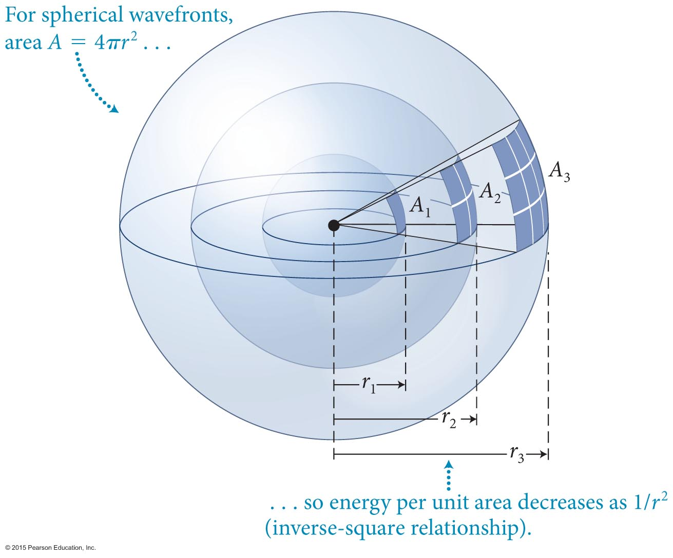
Section 17.1: Wavefronts
The waves that spread out in three dimensions are called spherical waves.
The energy carried by a spherical wavefront is spread out over a spherical area of
Area = 4πr².
So, for waves in three dimensions, Energy ~ r², and therefore amplitude
A ~ 1/r.
3D: E/Area = ½ μω ²A²

Slide 10
Checkpoint 17.2
Notice that in the views of the surface wave in Figure 17.1 the amplitude does not decrease with increasing radial distance r. How could such waves be generated?
17.2

Slide 11
Section 17.1
Clicker Question 1
Which of the following factors plays a role in how much a wave’s amplitude decreases as the wave travels away from its source? Answer all that apply.
Dissipation of the wave’s energy
Dimensionality of the wave
Destructive interference by waves created by other sources

Slide 12

Section 17.1
Clicker Question 1
Which of the following factors plays a role in how much a wave’s amplitude decreases as the wave travels away from its source? Answer all that apply.
Dissipation of the wave’s energy
Dimensionality of the wave
Destructive interference by waves created by other sources

Slide 13
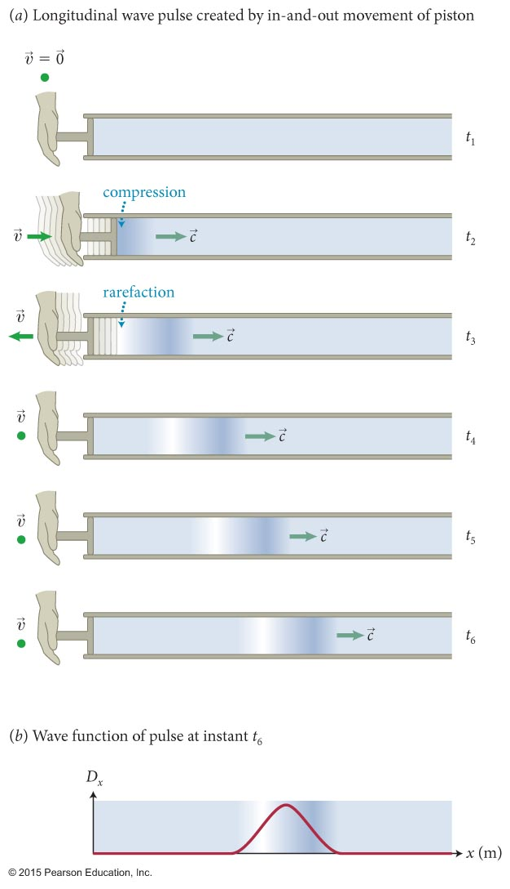
Section 17.2: Sound
Longitudinal waves propagating through any kind of material is what we call sound.
The human ear can detect longitudinal waves at frequencies from 20 Hz to
20 kHz.
Sound waves consist of an alternating series of compressions and rarefactions.
For dry air at 20° C, the speed of sound is 343 m/s.

Slide 14
Exercise 17.2 Wavelength of audible sound
Section 17.2: Sound
Given that the speed of sound waves in dry air is
343 m/s, determine the wavelengths at the lower and upper ends of the audible frequency range
(20 Hz–20 kHz).

Slide 15
Exercise 17.2 Wavelength of audible sound (cont.)
Section 17.2: Sound
SOLUTION The wavelength is equal to the distance traveled in one period. At 20 Hz, the period is
1/(20 Hz) = 1/(20 s^{–1}) = 0.050 s, so the wavelength is (343 m/s)(0.050 s) = 17 m. ✔
The period of a wave of 20 kHz is 1/(20,000 Hz) =
5 × 10^{–5} s, so the wavelength is (343 m/s)(5.0 × 10^{–5} s) = 17 mm. ✔

Slide 16
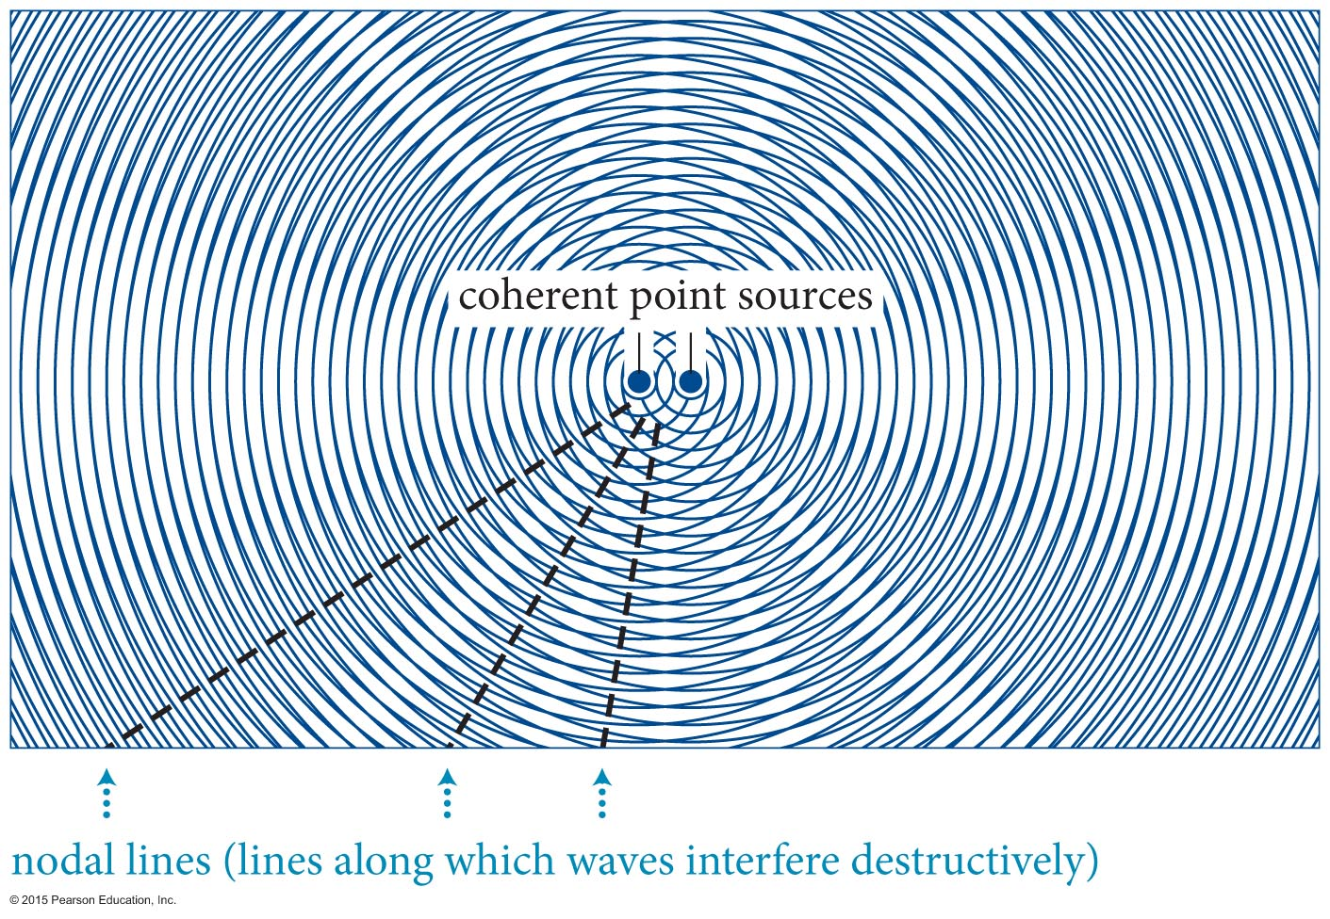
Section Goals
Section 17.3: Interference
You will learn to
Visualize the superposition of two or more two- or three-dimensional waves traveling through the same region of a medium at the same time.
Define and represent visually the nodal and antinodal lines for interference in two dimensions.

Slide 41
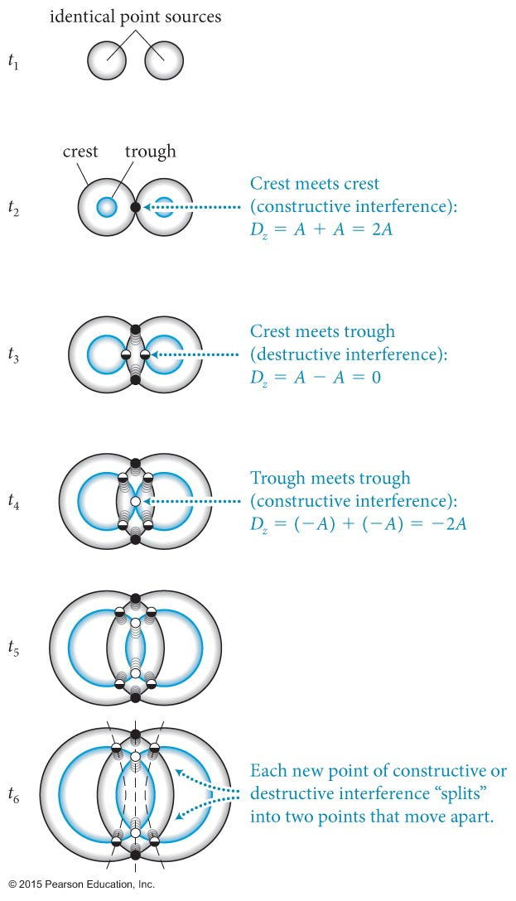
Section 17.3: Interference
Let us now consider the superposition of overlapping waves in two and three dimensions.
The figure shows the interference of two identical circular wave pulses as they spread out on the surface of a liquid.

Slide 42
Section 17.3: Interference
Sources that emit waves having a constant phase difference are called coherent sources.
The pattern produces by overlapping circular wavefronts is called a Moiré pattern.
Along nodal lines the two waves cancel each other and the vector sum of the displacement is always zero.

Slide 43
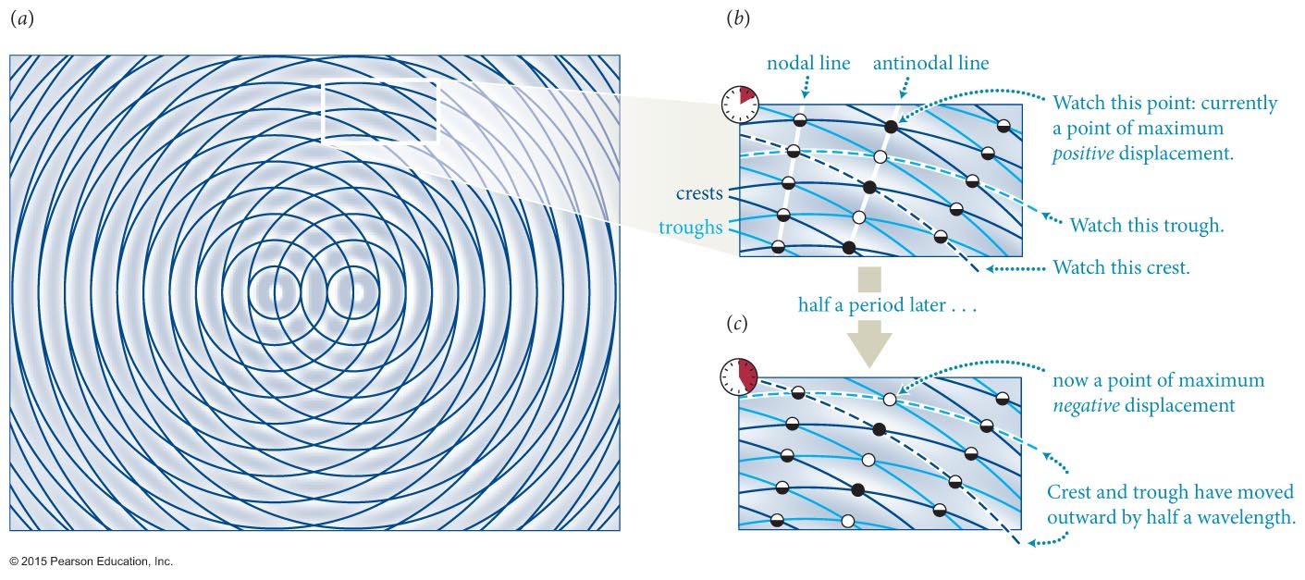
Section 17.3: Interference
set up on split screen
http://www.falstad.com/ripple/
The figure shows a magnified view of the interference pattern seen on the previous slide.
Along antinodal lines the displacement is a maximum.

Slide 44
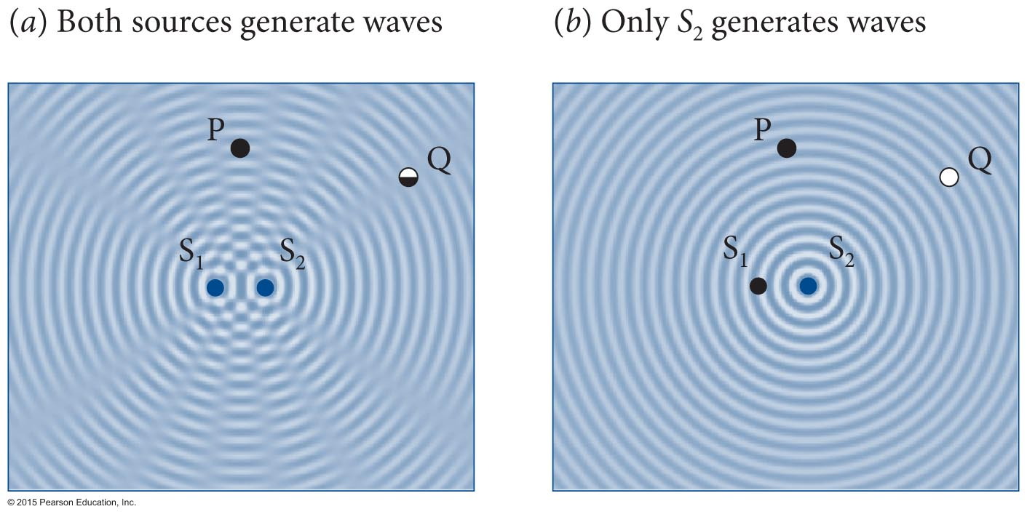
Section 17.3: Interference
One consequence of nodal regions is illustrated in the figure.
  When the waves from two coherent sources interfere, the amplitude of the sum of these waves in certain directions is less than that of a single wave.

Slide 45
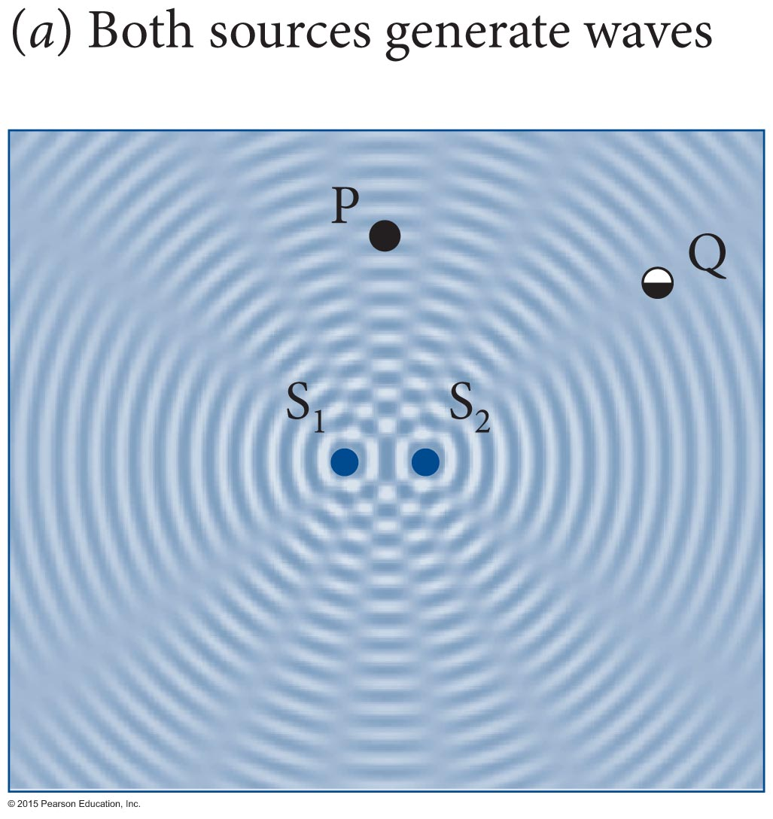
Checkpoint 17.9
By how many wavelengths are the sources in
Figure 17.16a separated?
17.9

Slide 46
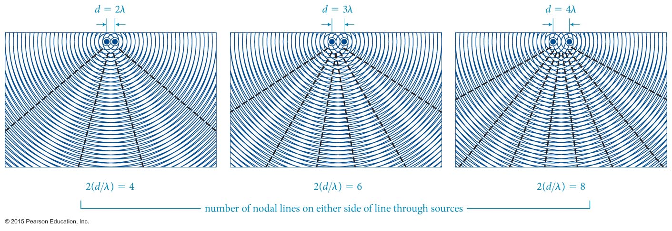
Section 17.3: Interference
The effect that the separation between the two point sources have on the appearance of nodal lines is shown in the figure.
  If two coherent sources located a distance d apart emit identical waves of wavelength λ, then the number of nodal lines on either side of a straight line running through the centers of the sources is the greatest integer smaller than or equal to 2(d/λ).

Slide 47
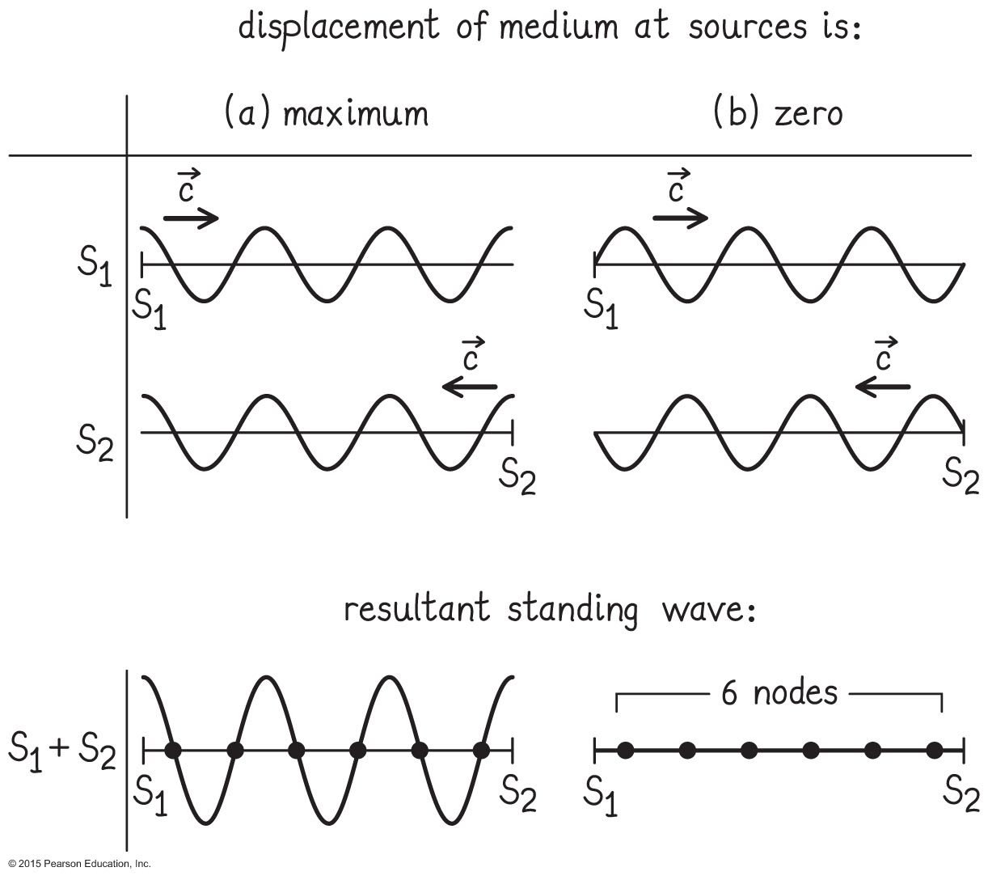
Example 17.3 Nodes (cont.)
Section 17.3: Interference
❸ EXECUTE PLAN Figure 17.18a shows, for the instant at which the medium displacement at both sources is maximum, the medium displacement caused by S₁ and S₂ and the sum of the two.

Slide 48
Checkpoint 17.10
Along the leftward and rightward extensions of the straight line joining S₁ and S₂ in Figure 17.16, why are there no nodes to the left of S₁ and to the right of S₂?
17.10

Slide 49
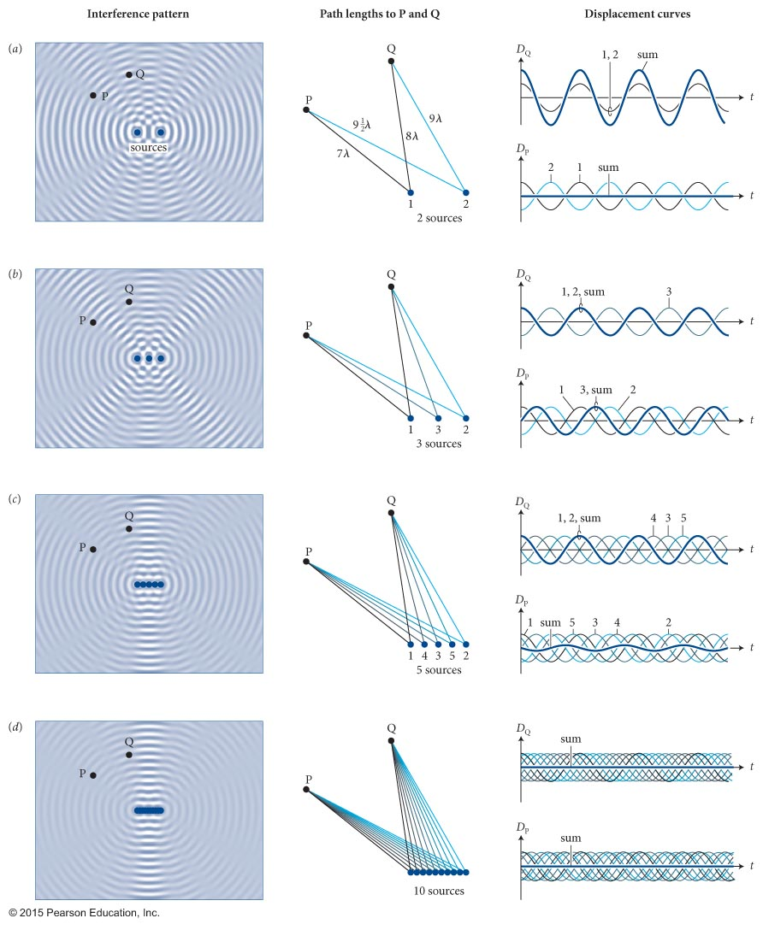
Interference
x
Two or more coherent sources.
x
x
x
x
x

Slide 50
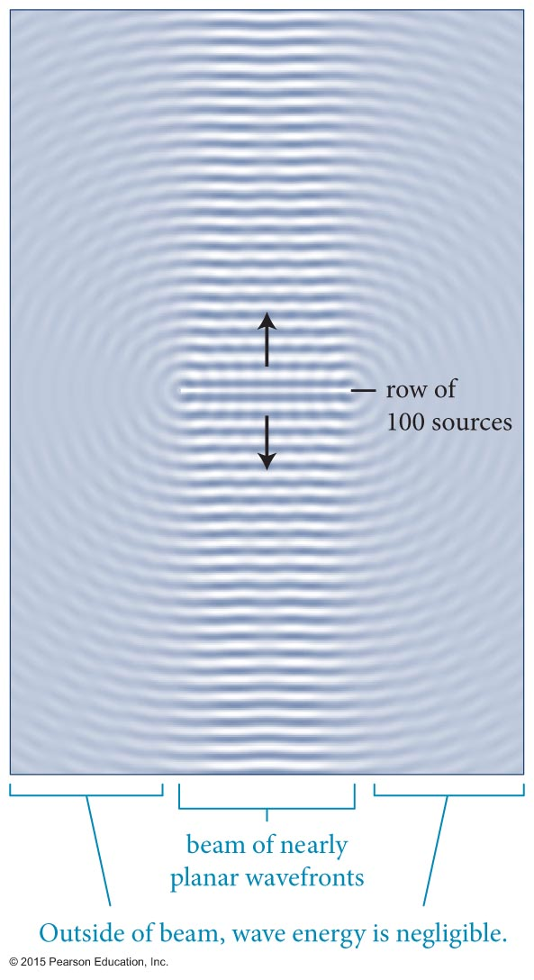
Section 17.3: Interference
The figure shows what happens when 100 coherent sources are placed close to each other:
  When many coherent point sources are placed close together along a straight line, the waves nearly cancel out in all directions except the direction perpendicular to the axis of the sources.

Slide 51
Checkpoint 17.11
How does the wave amplitude along the beam of wavefronts in Figure 17.20 change with distance from the row of sources?
17.11

Slide 52
Section 17.3
Clicker Question 3
Picture two identical coherent wave sources placed side by side and sending out waves that interfere with each other, creating a Moiré pattern. If the distance between the two sources is increased the number of nodal lines in the pattern
increases.
decreases.
stays the same.

Slide 53
Section 17.3
Clicker Question 3
Picture two identical coherent wave sources placed side by side and sending out waves that interfere with each other, creating a Moiré pattern. If the distance between the two sources is increased the number of nodal lines in the pattern
increases.
decreases.
stays the same.

Slide 54
Concepts: Characteristics of waves in two and three dimensions
Chapter 17: Summary
A wavefront is a curve or surface in a medium on which all points of a propagating wave have the same phase.
A planar wavefront is a flat wavefront that is either a plane or a straight line.
A surface wave is a wave that propagates in two dimensions and has circular wavefronts.
A spherical wave is a wave that propagates in three dimensions and has spherical wavefronts.

Slide 55
Concepts: Characteristics of waves in two and three dimensions
Chapter 17: Summary
According to Huygens’ principle, any wavefront may be regarded as a collection of many closely spaced, coherent point sources.
Diffraction is the spreading out of waves either around an obstacle or beyond the edges of an aperture. The effect is more pronounced when the size of the obstacle or aperture is about equal to or smaller than the wavelength of the wave.

Slide 56
Quantitative Tools: Characteristics of waves in two and three dimensions
Chapter 17: Summary
If no energy is dissipated, the amplitude A of a wave originating at a point source decreases with increasing distance r from the source as
  or
The intensity I (in W/m²) of a spherical wave that delivers power P to an area A oriented normal to the direction of propagation is

Slide 57
Quantitative Tools: Characteristics of waves in two and three dimensions
Chapter 17: Summary
If a point source emits waves uniformly in all directions at a power P_{s} and no energy is dissipated, the intensity a distance r from the source is
The intensity I_{surf} (in W/m) of a surface wave that delivers power P to a length L oriented normal to the direction of propagation is

Slide 58
Concepts: Sound waves
Chapter 17: Summary
Sound is a longitudinal compressional wave propagating through a solid, liquid, or gas. The wave consists of an alternating series of compressions (where the molecules of the medium are crowded together) and rarefactions (where the molecules are spaced far apart). The frequency range of audible sound is 20 Hz to 20 kHz.
The speed of sound c depends on the density and elastic properties of the medium. In dry air at 20° C, the speed of sound is 343 m/s.

Slide 59
Quantitative Tools: Sound waves
Chapter 17: Summary
The threshold of hearing I_{th} is the minimum sound intensity audible to humans. For a 1.0-kHz sound,
I_{th} ≈ 10^{–12} W/m².
For a sound of intensity I, the intensity level β in decibels is

Slide 60
Concepts: Interference effects
Chapter 17: Summary
Two or more sources emitting waves that have a constant phase difference are called coherent sources. If that constant phase difference is zero, the sources are said to be in phase.
Along nodal lines, waves cancel each other, and so the displacement of the medium is zero. Along antinodal lines, the displacement of the medium is a maximum.
The superposition of two waves of equal amplitude but slightly different frequencies results in a wave of oscillating amplitude. This effect is called beating.

